Slide 1
Cluster Analysis
MSCI:6070 Data Science
k-means clustering
Notes:
hm2 tree

Slide 2
When to use clustering?
to perform segmentation, be it customer, product or store. We have already talked about customer segmentation using cluster analysis in the example above. Similarly products can be clustered together into hierarchical groups based on their attributes like use, size, brand, flavor etc; stores with similar characteristics – similar sales, size, customer base etc, can be clustered together.
for anomaly detection, for example, identifying fraud transactions. Cluster detection methods can be used on a sample containing only good transactions to determine the shape and size of the “normal” cluster. When a transaction comes along that falls outside the cluster for any reason, it is suspect. This approach has been used in medicine to detect the presence of abnormal cells in tissue samples and in telecommunications to detect calling patterns indicative of fraud.
to break large set of data into smaller groups that are more amenable to other techniques. For example, logistic regression results can be improved by performing it separately on smaller clusters that behave differently and may follow slightly different distributions.
In summary, clustering is a powerful technique to explore patterns structures within data and has wide applications is business analytics. There are various methods for clustering. An analyst should be familiar with multiple clustering algorithms and should be able to apply the most relevant technique as per the business needs.
Notes:
Examples: Market segmentation
Application is to categorize groups and then run supervised learning on them
separating of populations
Dimension reduction-identify groups of variables (to replace with just one variable) to reduce features
switch your x and y variables so features on x and observations y)

Slide 3
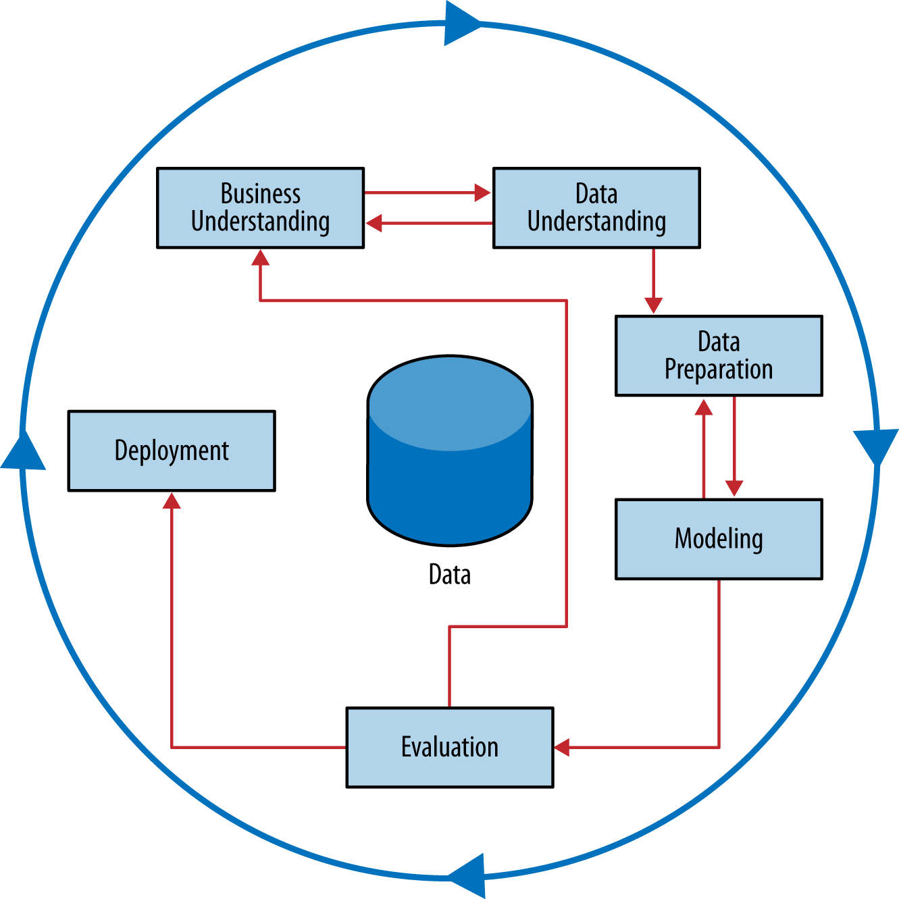
Stepping Back: Solving a Business Problem Versus Data Exploration
In predictive modeling examples, including those using similarity directly, we focused on solving a very specific business problem.
Often in Business understanding phase, the problem is not well-defined. We would like to explore the data, possibly with only a vague notion of the exact problem we are solving
Supervised problems are specific; unsupervised problems are much more exploratory
e.g., Supervised: to improve the prediction of defection when a customer’s contract is about to expire
Unsupervised: to cluster customers in order to improve something
trade-off in where and how time and effort is expended in the data mining process
Notes:
One of the fundamental concepts of data science is that one should work to define as precisely as possible the goal of any data mining
We should spend as much time as we can in the business understanding/ data understanding mini-cycle, until we have a concrete, specific definition of the problem we are trying to solve.

Slide 4
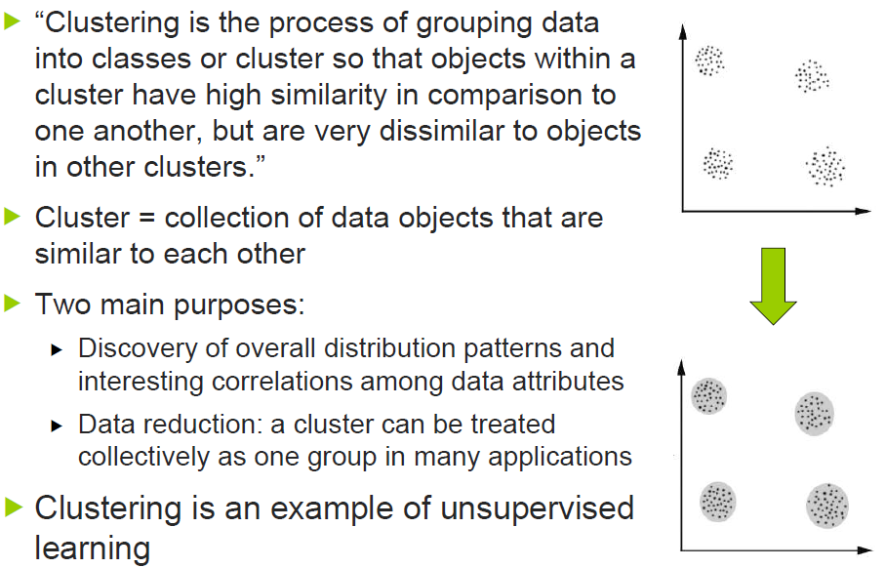
What is Clustering?

Slide 5
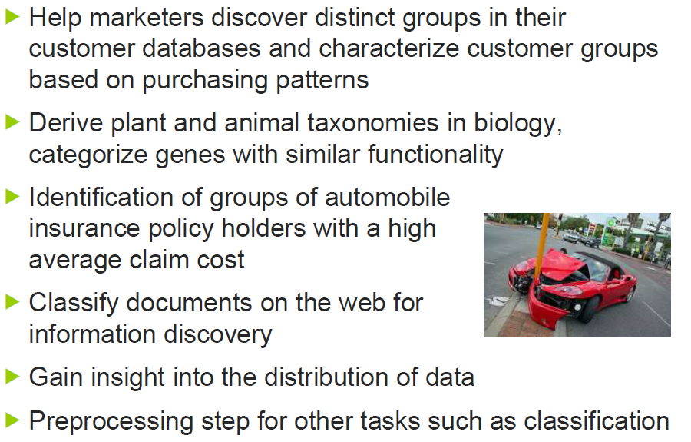
Applications
Notes:
Nested clustering-hierarchical clustering

Slide 6


Example:
Features: gender, race, age, occupation, browsing history, etc
e.g., male, white, 23, student, facebook.com, twitter.com, cnn.com, ….
Find the most similar consumers from the database
Notes:
Things get messy when you combine categorical and numerical data types.
All categorical or all numerical we are ok (cleaner)

Slide 7
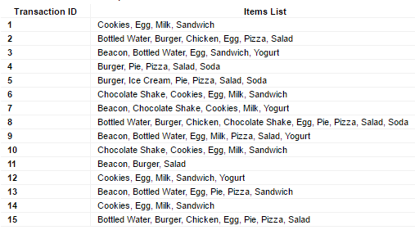
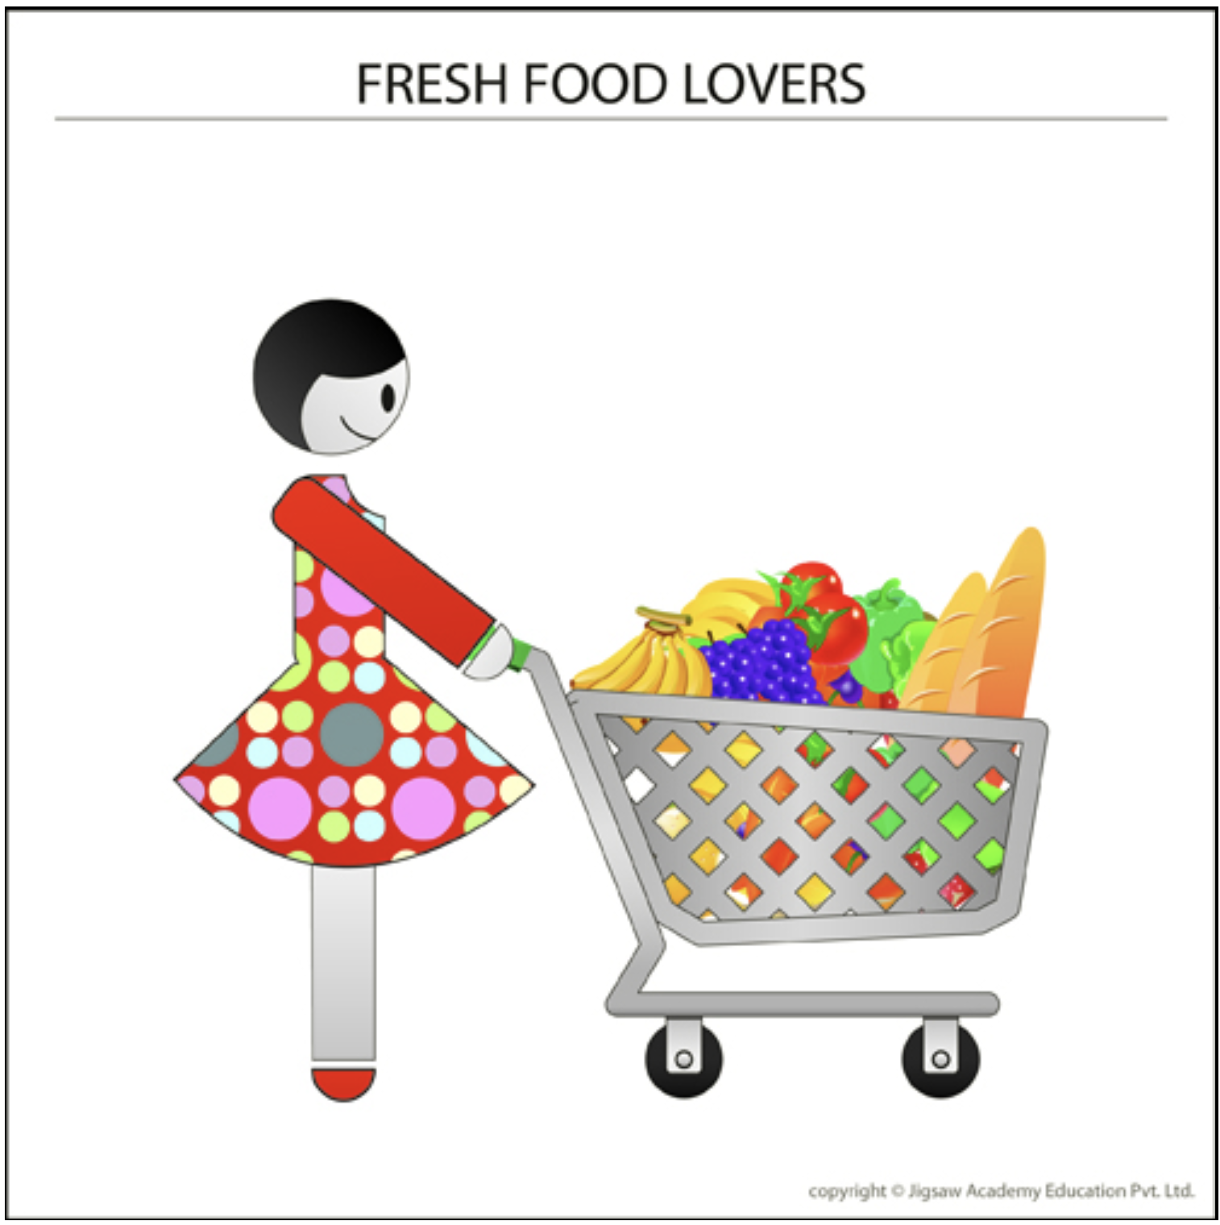
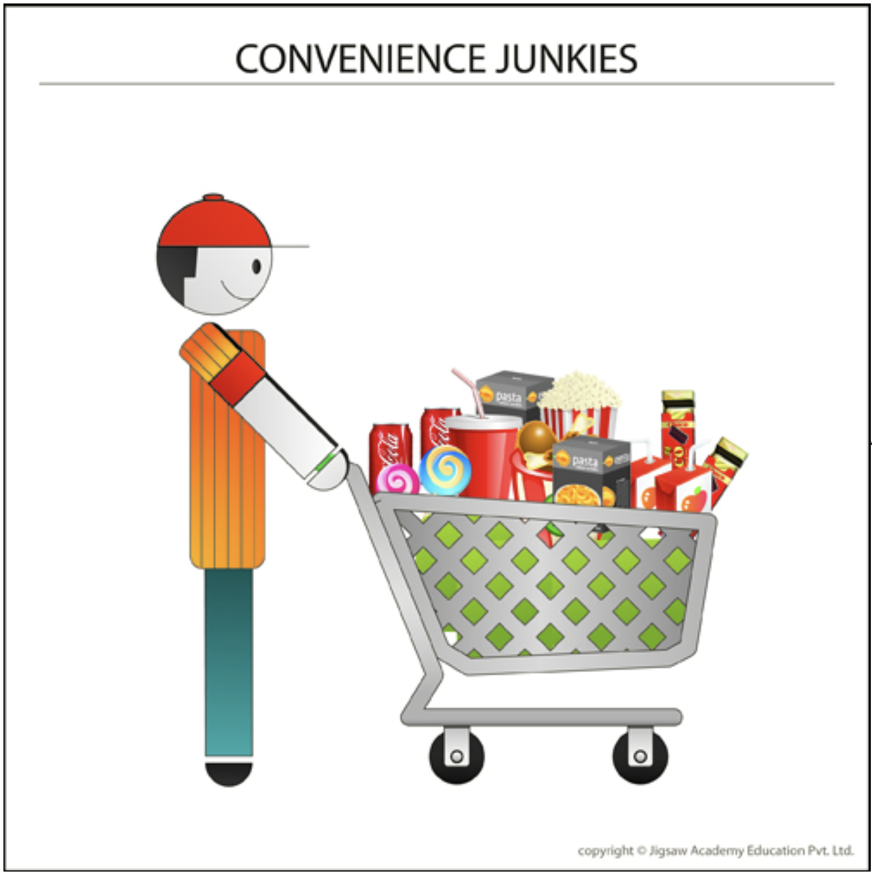
An Example
A grocer retailer used clustering to segment its 1.3MM loyalty card customers into several different groups based on their buying behavior. It then adopted customized marketing strategies for each of these segments in order to target them more effectively.
Feature vectors: transaction history
Observation | cookies | egg | Sardines
1 | 1 | 1 | 0
2 | 0 | 1 | 0
Notes:
Categorical data-just do counts
Type of food ends up being features and observations are transaction ID
How do we cluster-just match 1’s (Jaccard’s coefficient)
Above matches eggs and sardines, but we don’t count the matches 0’s

Slide 8
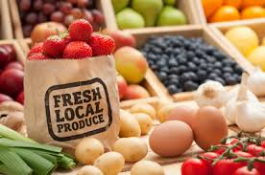
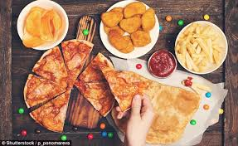

An Example
Cluster 1 - ‘Fresh food lovers’. This comprised of customers who purchase a high proportion of organic food, fresh vegetables, salads etc. A marketing campaign that emphasized the freshness of the fruits and vegetables and year-round availability of organic produce in the stores appealed to this customer group.
Cluster 2 - ‘Convenience junkies’. This comprised of people who shopped for cooked/semi-cooked, easy-to prepare meals. A marketing campaign focusing on the retailer’s in-house line of frozen meals as well as the speed of the check-out counters at the store worked well with this audience.
Cluster 3 - ‘Deal seakers’. This comprised of people who love to buy products on sale or promotion, or use coupons.

Slide 9
A note on Clustering
Cluster analysis can be used to discover structures in data without providing an explanation or interpretation. In other words, cluster analysis simply discovers patterns in data without explaining why they exist. The resulting clusters are meaningless by themselves. They need to be profiled extensively to build their identity i.e. to understand what they represent and how they are different from the parent population.
In the retailer’s case, each cluster was profiled on its buying behavior. Customers in cluster 1 spent a quarter of their total spend on fresh, organic produce. This was significantly higher than other customers who spent less than 5% on this category. This segment of customers was called ‘Fresh food lovers’ as this is what distinguished them from the rest of the customers.

Slide 10
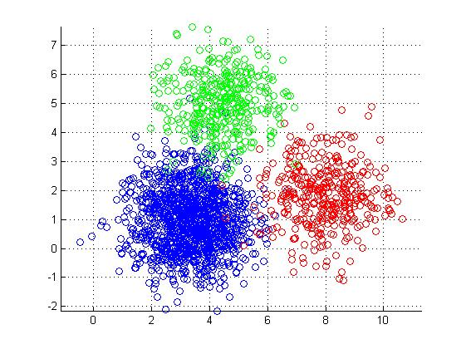
Applications of Clustering
Market research
partition the general population of consumers into market segments and to better understand the relationships between groups of consumers
Product development
Crime analysis

Slide 11
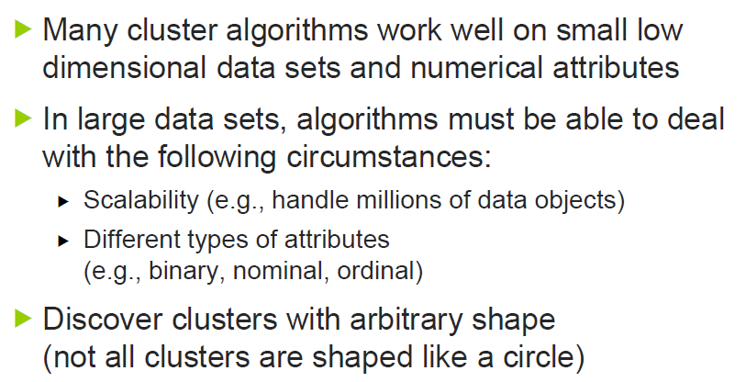
Challenges in Clustering

Slide 12
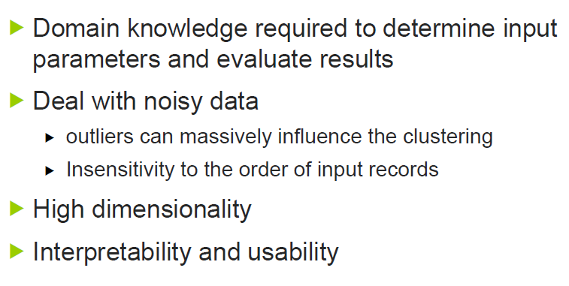
Other Clustering Considerations

Slide 13
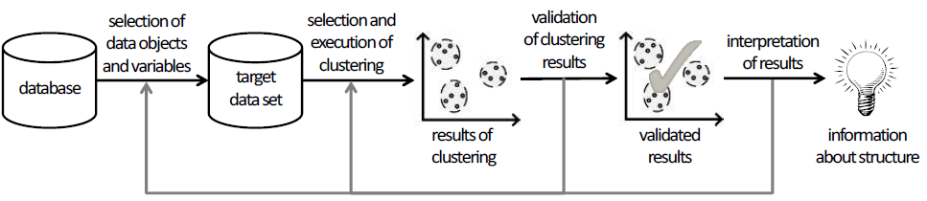
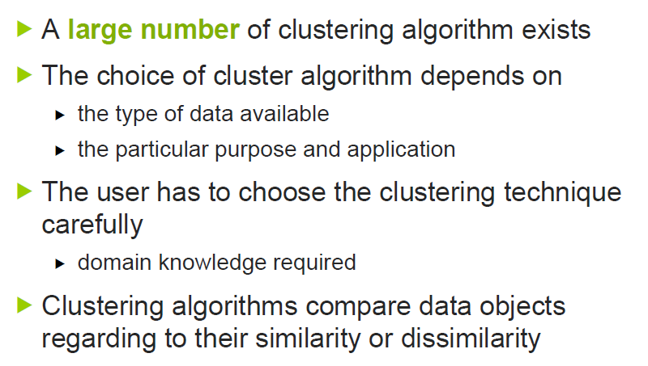

Slide 14
Similarity and Distance
Similarity is at the core of many data mining methods
If two things are similar in some ways, they often share other characteristics as well
Typically, distances between data points are used for the determination of similarity
Some business cases
Predict behavior of a new customer
Reasoning from similar cases (medicine, law)
Notes:
We saw this implicitly in previous topics where modeling procedures create boundaries for grouping instances together that have similar values for their target variable
reasoning about similar historical cases is a natural way of coming to a decision about a new case

Slide 15
Clustering
Unsupervised segmentation that looks for “natural groupings” in data
Clustering is another application of our fundamental notion of similarity.
The basic idea is that we want to find groups of objects (consumers, products, etc), where
objects within the same group are similar
objects in different groups are not so similar
Cluster = collection of data objects that are similar to each other

Slide 16
Clustering algorithms
The notion of a "cluster" cannot be precisely defined, which is one of the reasons why there are so many clustering algorithms
Algorithms
Centroid-based clustering
k-means
Connectivity-based clustering
hierarchical clustering

Slide 17
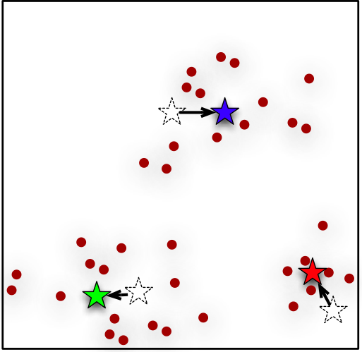
Centroid-based Clustering works best on numerical data
Idea: a cluster is represented by a its cluster center, or centroid
Centroid is NOT necessarily one of the instances; it is the geometric center of a group of points
Applies to numeric data
Notes:
hierarchical clustering focuses on the similarities between the individual instances and how similarities link them together. A different way of thinking about clustering data is to focus on the clusters themselves -groups of instances. Represent each cluster by its cluster center, or centroid.

Slide 18
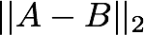
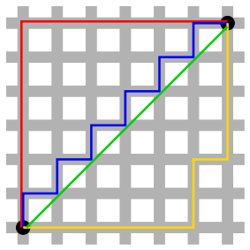
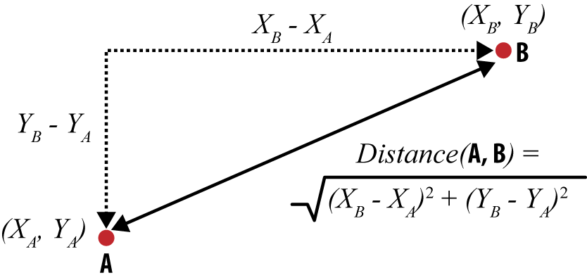
Distance for Numeric data
Distances for numeric data:
Euclidean distance
Example:
Manhattan distance
aka. taxicab metric
Example:
 | Person A | Person B
Age | 23 | 40
Years at current address | 2 | 10
Yrs in the loyalty program | 2 | 1
Notes:
two points in feature space, Closer they are, the more similar they are
enclidean: a measurement of distance from basic geometry
Age new = (age old – age min) / (age max – age min) gives [0,2]

Slide 19
K-means Clustering
the “means” are the centroids = arithmetic means (averages) of the values along each dimension for the instances in the cluster
the “K” is the number of clusters
Notes:
Shabal.in/visuals/kmeans/4.html

Slide 20
K-means Algorithm
Method:
Arbitrarily choose k objects as the initial cluster centers
repeat
reassign each object to the closest cluster based on the cluster centers
update the cluster centers, i.e., calculate the mean value of the objects in each cluster
until no change

Slide 21
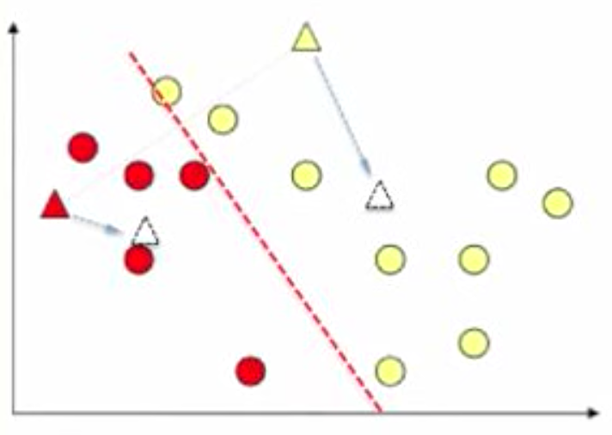
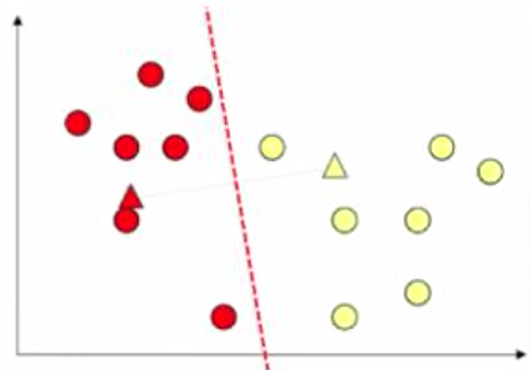
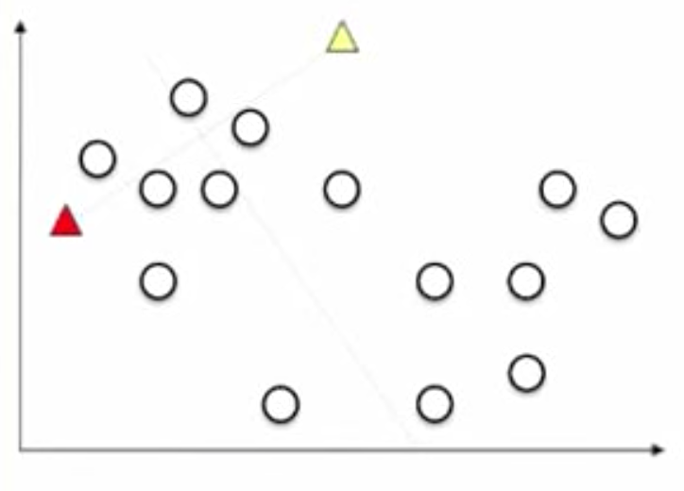
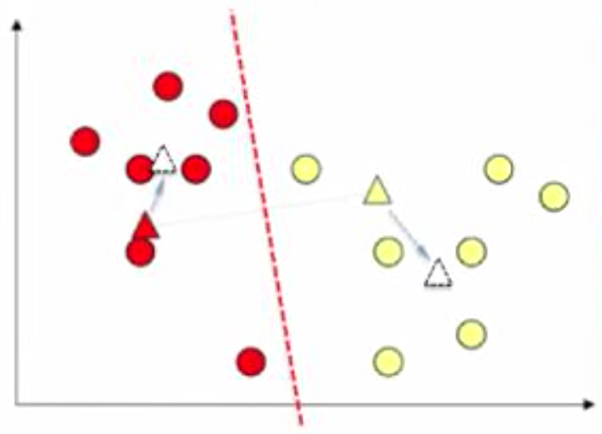
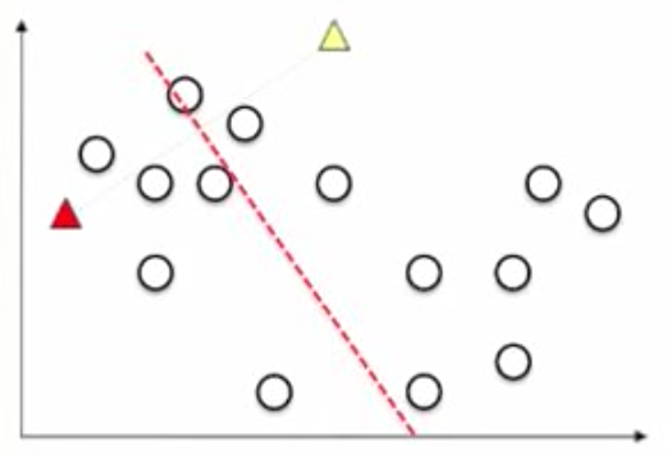
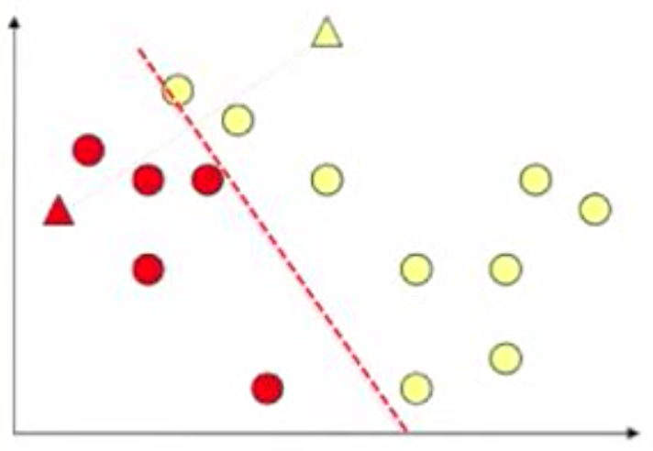
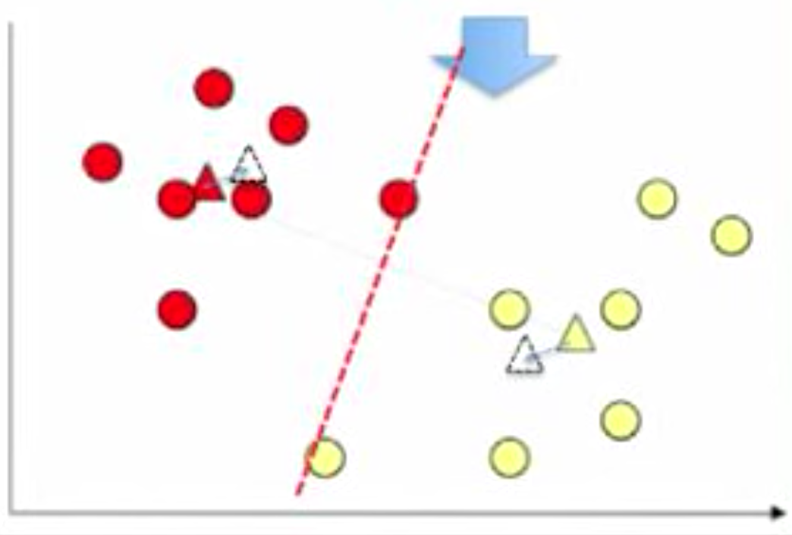
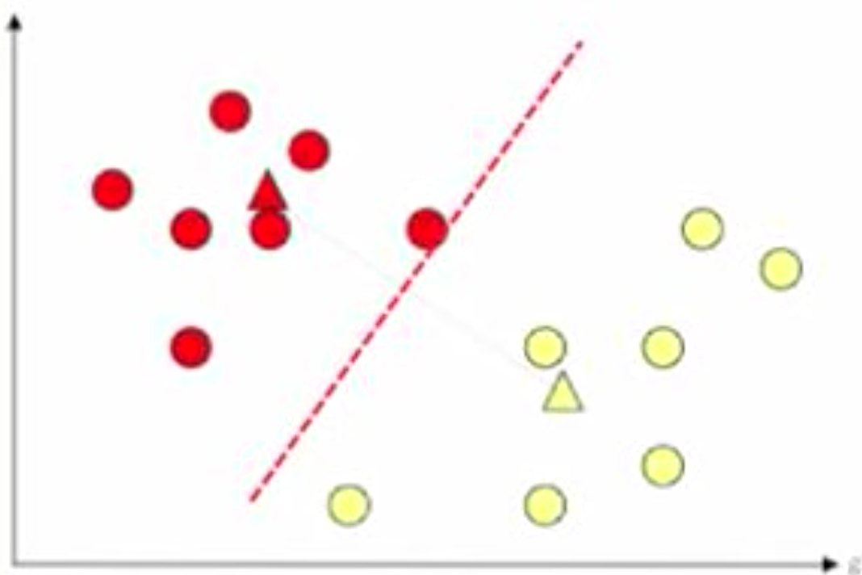
K-means Clustering Example
Arbitrarily choose k objects as the initial cluster centers
repeat
reassign
update
until no change

Slide 22
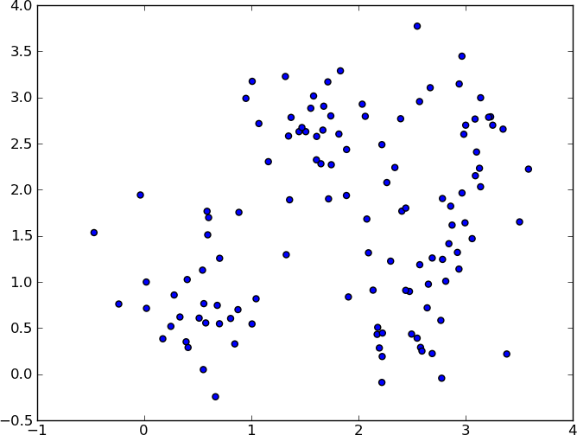
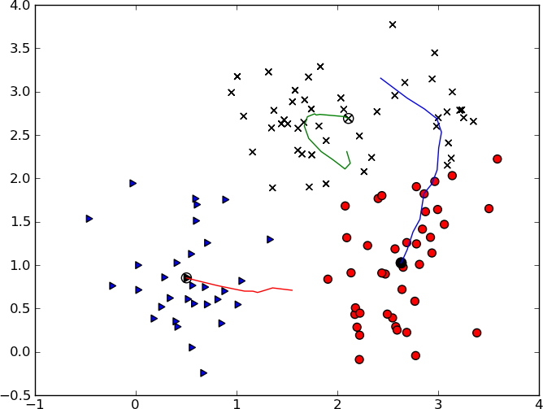

An Example on 90 data points
after 16 iterations

Slide 23
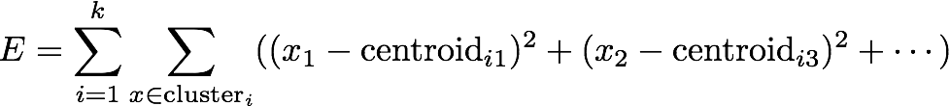
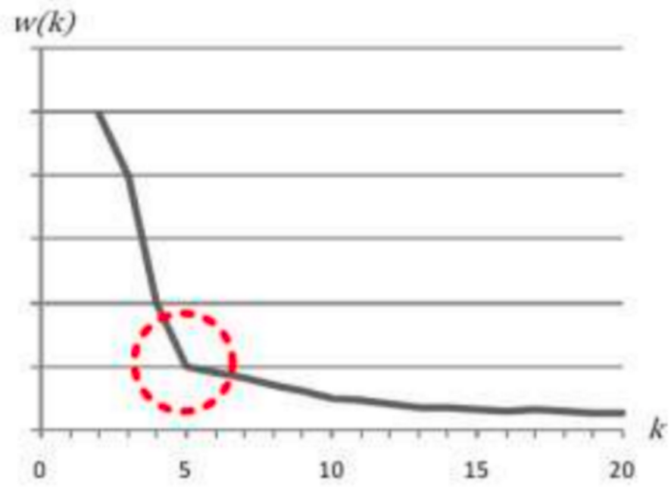

Determination of K
Many cluster algorithms require the number k of clusters
Unfortunately, there is no definitive answer to this question. The optimal clustering is somehow subjective and depend on the method used for measuring similarities and the parameters used for partitioning.
Example — Elbow method
Recall that, the basic idea behind k-means clustering, is to define clusters such that the total intra-cluster variation (known as total within-cluster variation or total within-cluster sum of square) is minimized.
The total within-cluster sum of square (wss) measures the compactness of the clustering and we want it to be as small as possible.
WSS
Number of features
w(k) can use other indices
Notes:
Example

Slide 24

Determination of K
Number of features
(0.6,1.7)
(1.7,1.8)
(1.1,1.5)
(1.1,1)
(0.4,0.6)
(0.5,0.3)
(0.6,0)

Slide 25
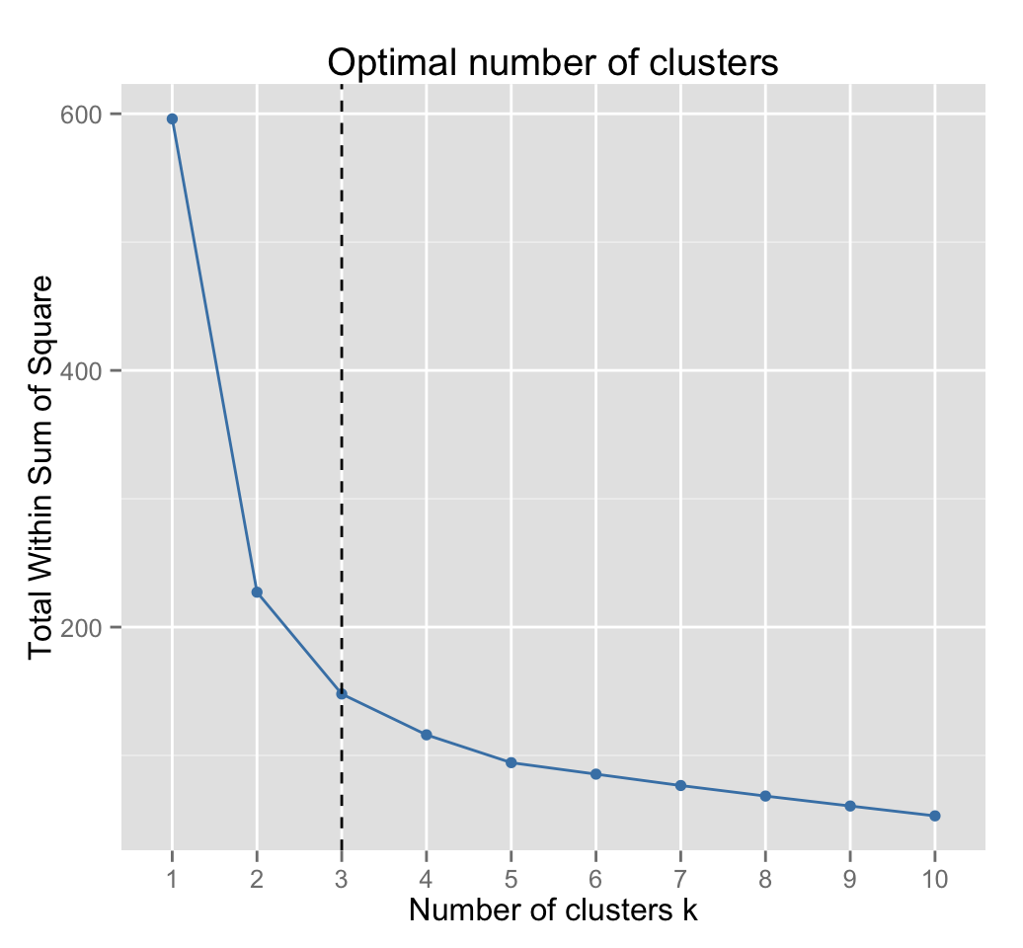
Elbow Method
1. Compute clustering algorithm (e.g., k-means clustering) for different values of k. For instance, by varying k from 1 to 10 clusters
2. For each k, calculate the total within-cluster sum of square (wss)
3. Plot the curve of wss according to the number of clusters k.
4. The location of a bend (knee) in the plot is generally considered as an indicator of the appropriate number of clusters.
Notes:
subjective

Slide 26
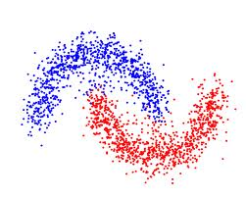
Can K-means find clusters as below?

Slide 27
General Remarks on K-means
works well when clusters are compact clouds and well separated
scalable and efficient in large data sets
More efficient than Hierarchical clustering
often terminates at local optimum
mean must be defined (e.g., not suitable for categorical attributes)
sensitive to noisy and outlier data
why?
curse of dimensionality: as number of features increases all observations become equidistant

Slide 28
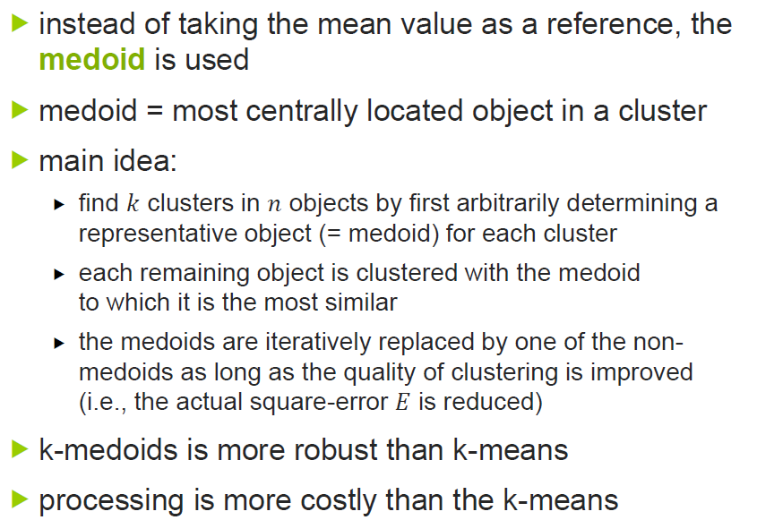
K-Medoids Clustering
Notes:
Repeated clustering on different training sets and get same conclusions (70/15/15) and change seed for each run

Slide 29
Entropy-Weighted K-Means Clustering
Employs subset clustering by weighting each variable’s contribution to the distance measure
Weight of a variable corresponds to the probability that the variable contributes in the identification of a cluster
Aimed to address complications caused by large number of variables
Notes:
Lambda values less than 1 lead to a more uneven variable weighting. Lambda values greater than 3 lead to a relatively even distribution of weights. Typically Lambda is between 1 and 3.
Under clustering Ewkm option

Slide 30
Model Evaluation
The evaluation of unsupervised learning is difficult
There is no goal model to compare with
The true result is unknown, it may depend on the context, the task to perform, …
Why do we want to evaluate them?
To avoid finding patterns in noise
To compare clustering algorithms
To compare different models/parameters

Slide 31
Model evaluation - what can be evaluated?
Cluster tendency, are there clusters in the data?
Quality of the clusters without reference to external information
For instance, SSE, interclass distance, inner class distance
Evaluate algorithm parameters
For instance, to determine the correct number of clusters

Slide 32
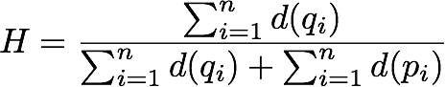
Clustering Tendency
Before clustering a dataset we can test if there are actually clusters
Test on spatial randomness of the data set: determine how far away the data is from being uniformly distributed in the data space.
Hopkins statistic
Sample n points (pi) from a data set D and compute the distance to their nearest neighbor (d(pi))
Generate n points (qi) uniformly distributed in the space of the dataset and compute their distance to nearest neighbors in D (d(qi))
Compute the quotient:
Null hypothesis: data set is uniformly distributed
Alternative hypothesis: data set is not uniformly distributed (i.e., contains clusters)
H > 0.75 implies clustered data at 90% confidence level
Notes:
Using hopkins() function in clustertend package -> note that this returns 1 – H.
H is closer to one means data is closer to 1

Slide 33
Understanding the Results of Clustering
Understanding the clustering is important because clustering often is used in exploratory analysis, so the whole point is to understand whether something was discovered
How to examine the result?
Clustering algorithm provides with a list of assignments indicating which example belongs to which cluster
A cluster centroid describes the average cluster members
These descriptions are characteristic descriptions
Notes:
may be very detailed and they don’t tell us how the clusters differ

Slide 34
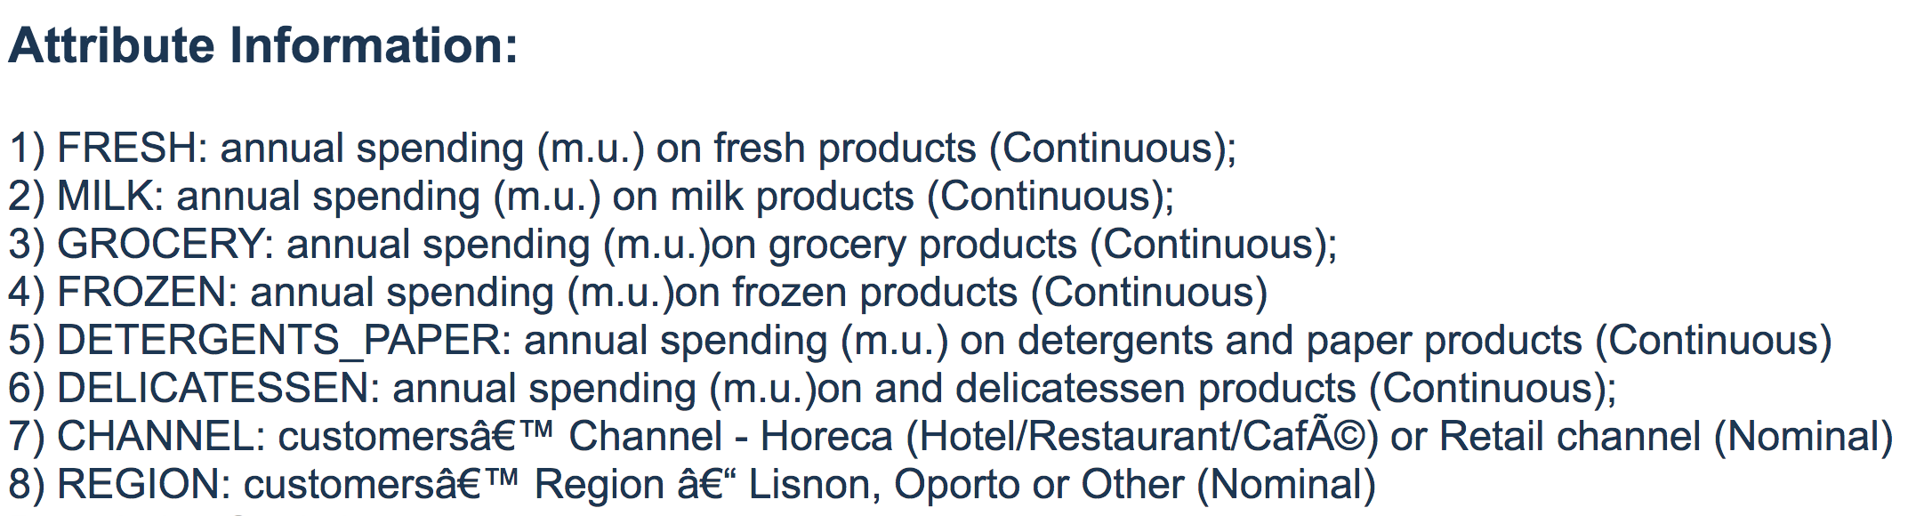
A demo on Rattle
Wholesale customers Data Set

